Slide 1
Data & Privacy (Part-2)
Tracking Technologies and Their Impact on Privacy

Slide 2
Learning Outcomes
By the end of this lesson, you will:
Understand what geolocation, cookies, and browsing history are and how they work.
Identify how these tracking technologies can collect data about you.
Recognize how aggregated data from these sources can create detailed knowledge about an individual.
Understand the impact of tracking technologies on privacy.
Learn how to protect your privacy from tracking technologies.

Slide 3
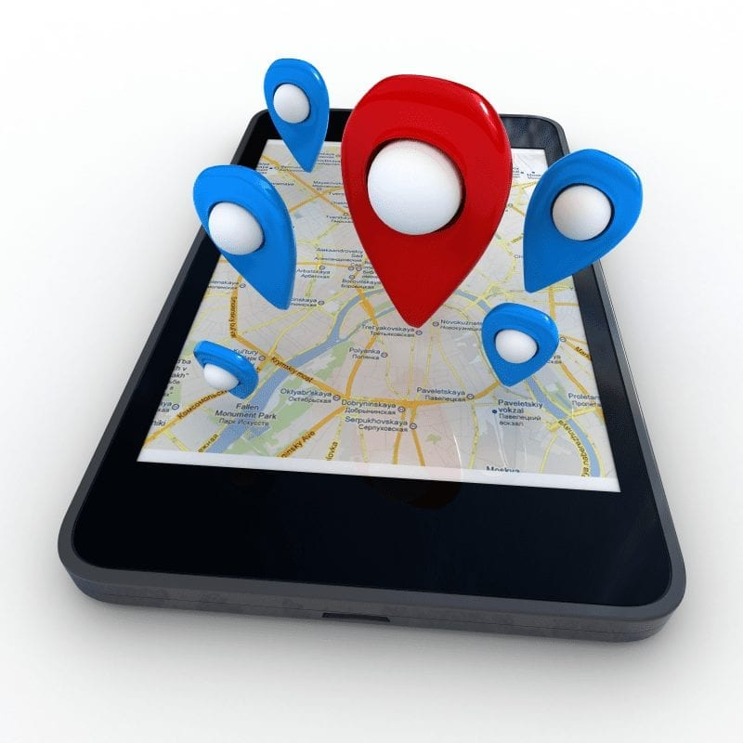
What is Geolocation ?
Definition: Geolocation refers to the identification of the geographical location of a device, like a phone or computer, using various methods such as GPS, Wi-Fi signals, or IP addresses.
How It Works: When you use a map app on your phone, it can pinpoint exactly where you are by connecting to satellites or Wi-Fi networks. Websites and apps can also determine your location based on your IP address (a unique code linked to your internet connection).
Example: Google Maps can tell where you are and suggest nearby restaurants or traffic updates based on your location.
Why It Matters: Geolocation is useful for navigation, but it can also track where you've been or where you are right now.

Slide 4
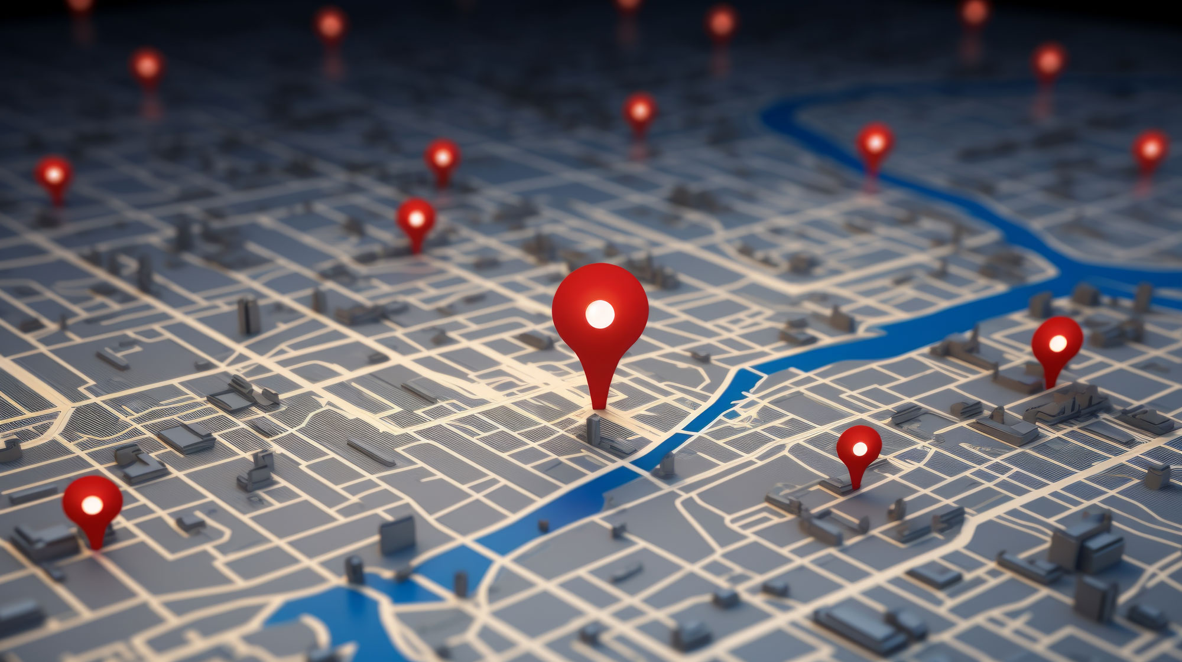
The Privacy Risks of Geolocation
Constant Location Tracking: Some apps track your location even when you're not actively using them. This can reveal a lot about your daily routines, like where you live, where you go to school, or which places you visit.
Sharing Without Consent: Some apps might share your location with advertisers or other companies without asking you first. For example, if you're at a shopping mall, you might suddenly get ads for stores nearby.
Example: A weather app may collect your location to give you accurate weather updates, but it might also sell this data to advertisers who want to know which stores you're near.

Slide 5

What are Cookies ?
Definition: Cookies are small files stored on your computer by websites you visit. They remember information about you, like your preferences, login details, or items in your shopping cart.
Types of Cookies:
Session Cookies: These are temporary and get deleted once you close your browser. They’re useful for things like keeping you logged in while you browse a site.
Persistent Cookies: These stay on your device even after you close the browser. Websites use them to remember you the next time you visit, so you don’t have to log in again.
Example: When you visit an online store and add items to your cart, cookies remember your cart even if you close the website and come back later.

Slide 6

The Privacy Risks of Cookies
Tracking Your Browsing: Cookies can track what you do on websites, such as what you click on, how long you stay, and even what you’re interested in. This data is often used to create targeted ads.
Third-Party Cookies: These cookies come from companies other than the website you’re visiting. They track your behavior across different sites to build a profile about you. For example, if you look at shoes on one website, you might see shoe ads on other websites too.
Example: After visiting a travel site, you might notice ads for flights or hotels on other sites, thanks to third-party cookies tracking your interests.

Slide 7
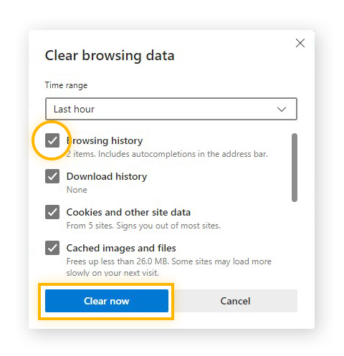
What is Browsing History ?
Definition: Browsing history is a record of all the websites you've visited, along with the dates and times you visited them.
How It Works: Every time you visit a website, your browser saves the address of that page in its history. This can be useful for going back to a page you visited earlier.
Why It Matters: Your browsing history can reveal a lot about your interests, habits, and routines. Companies can use this data to create a profile of you based on your online activities.
Example: If you visit a lot of cooking websites, companies might assume you're interested in food and show you ads for recipes or cooking tools.

Slide 8
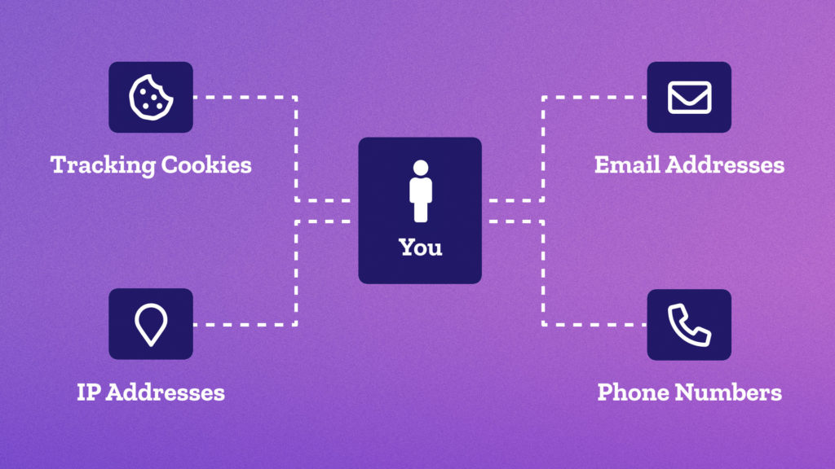
How Geolocation, Cookies, and Browsing History Work Together
Aggregation of Data: When geolocation, cookies, and browsing history are combined, they can create a detailed profile of a person’s habits, preferences, and interests.
Example of Aggregation:
Geolocation: Your phone tracks your location.
Cookies: Websites track your behavior and shopping habits.
Browsing History: Your search for new shoes is saved.
Combined: Companies can use this information to send you ads for shoe stores near you or offer discounts for local shops.
Why It Matters: Aggregating data allows companies to understand your habits better, but it can also invade your privacy by collecting more data than you realize.

Slide 9

The Impact of Tracking Technologies on Privacy
Loss of Privacy: Tracking technologies like geolocation, cookies, and browsing history can lead to a loss of privacy because they collect data about your activities without you always knowing.
Targeted Advertising: Companies use tracking data to show you personalized ads based on your interests. While this can be helpful, it also means they know a lot about your habits.
Example: If you visit many websites about gaming, you might start seeing ads for new video games or accessories. This is based on data collected from your browsing habits, even if you didn’t give permission for this kind of tracking.

Slide 10
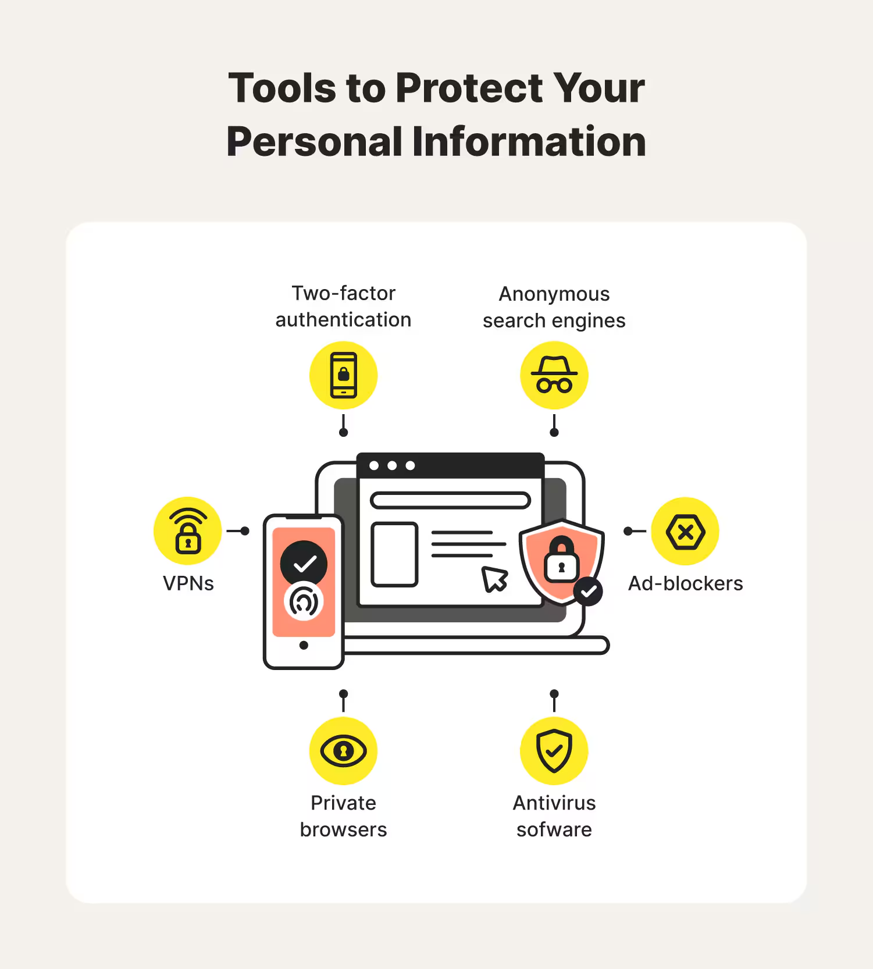
How to Protect Your Privacy from Tracking Technologies
Tip 1: Turn Off Location Services: Disable location services for apps that don’t need them, especially when you’re not using them.
Tip 2: Clear Cookies Regularly: Deleting cookies from your browser can help reduce how much websites track you. You can also use your browser’s private or incognito mode to prevent cookies from being saved.
Tip 3: Manage Your Browsing History: Clear your browsing history regularly and use tools that prevent your online activity from being tracked.
Example: When using your browser, you can set it to block third-party cookies to avoid tracking across different websites.

Slide 11
MCQs (Multiple Choice Questions)
1. What is geolocation?
a. The ability to store cookies on a device
b. The process of finding someone’s location using technology
c. Tracking someone’s browsing history
d. The storage of personal data on a website

Slide 12
2. What do cookies do?
a. Track your location
b. Store information like your preferences or login details
c. Monitor your phone’s calls
d. Collect your browsing history

Slide 13
3. Which of the following is an example of browsing history?
a. Your current GPS location
b. A list of websites you’ve visited
c. A map of your home address
d. Your phone’s camera roll

Slide 14
4. How can companies use aggregated data from geolocation, cookies, and browsing history?
a. To delete all your personal data
b. To send you personalized ads
c. To store your phone number
d. To block websites you visit

Slide 15
5. How can you protect your privacy from tracking technologies?
a. Turn off your phone
b. Clear cookies and browsing history
c. Share your location with every app
d. Ignore privacy settings on websites

Slide 16

Homework Assignment
Task: Research how popular websites like Google, Facebook, or YouTube use geolocation, cookies, or browsing history to collect data. Prepare a one-page report on:
How these websites track your behavior.
What information they collect.
How you can protect your privacy while using them.

